Slide 1
Tutorial 1 – Environment Setting
Prof. Ren-Shuo Liu Willie Tsai

Slide 2
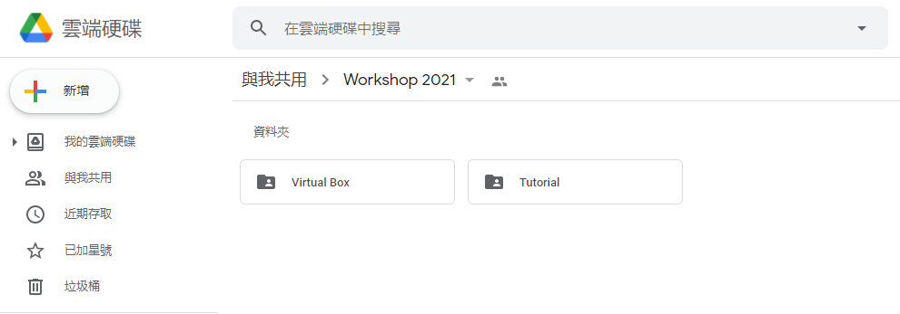
Download
Workshop Google Drive URL: ARCworkshop2021

Slide 3
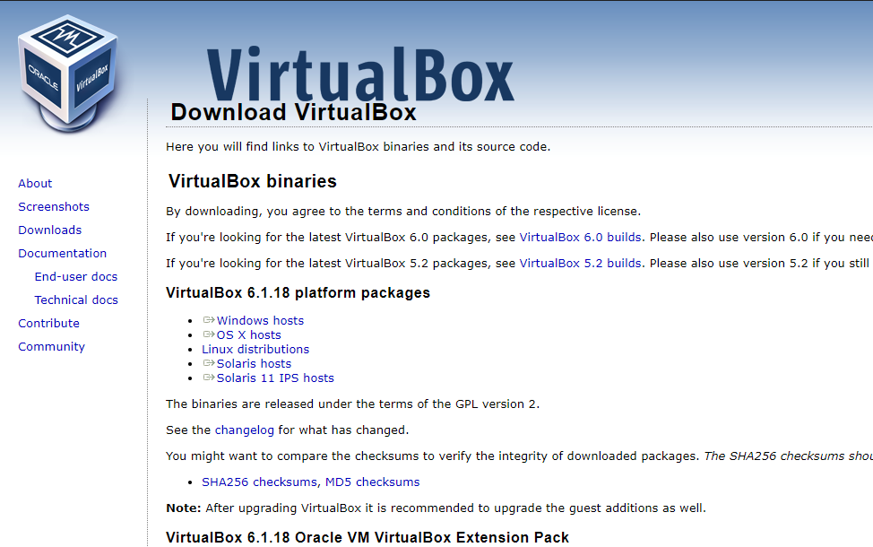
VirtualBox Installation

Slide 4
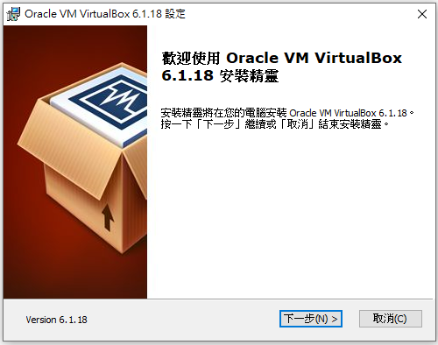
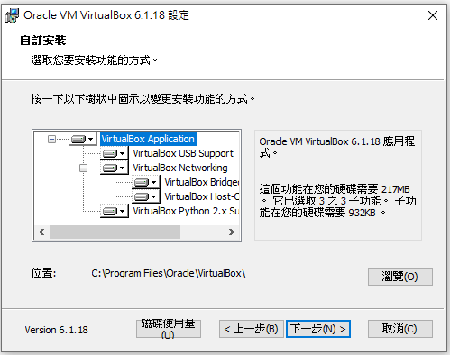
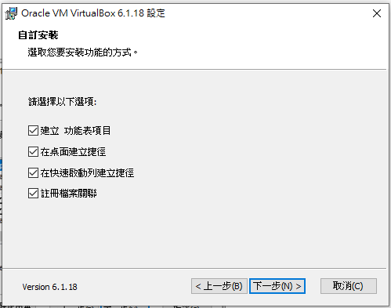
VirtualBox Installation

Slide 5
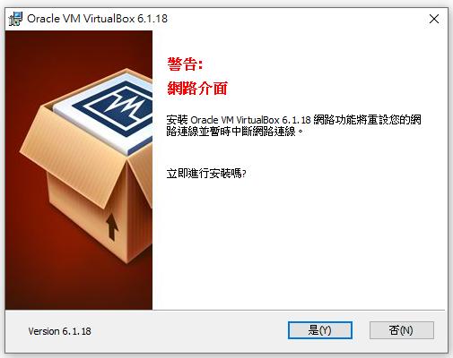
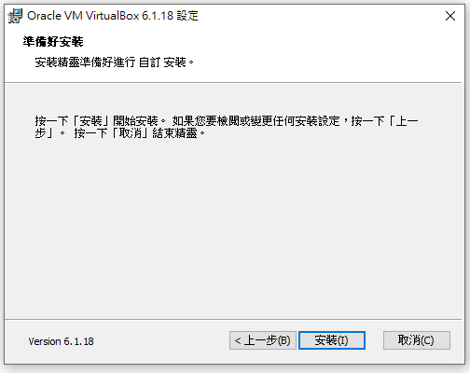
VirtualBox Installation

Slide 6
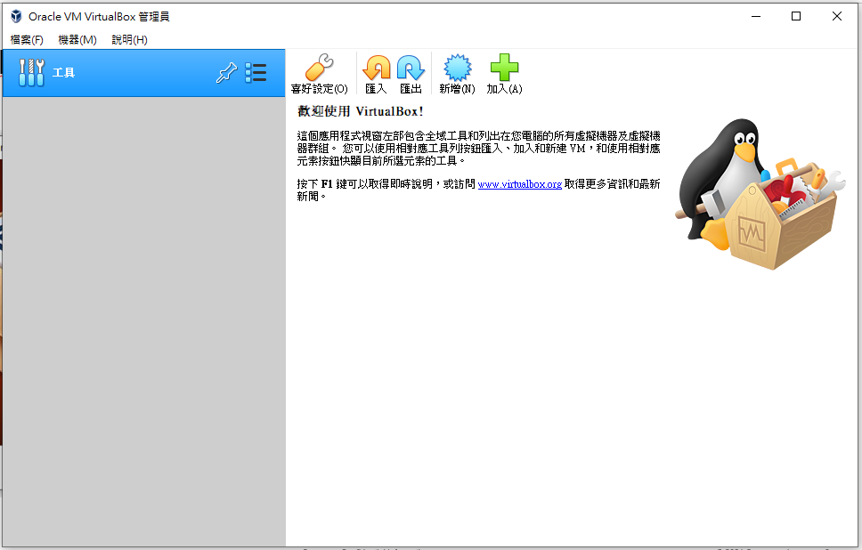
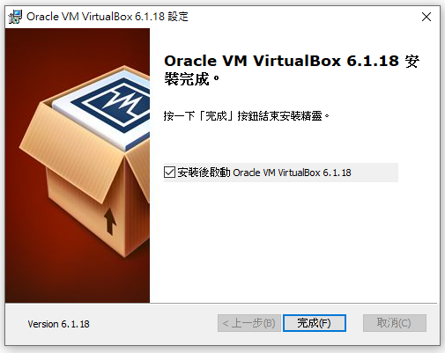
VirtualBox Installation

Slide 7
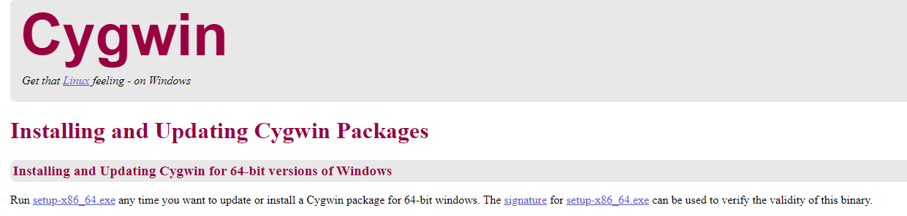
Cygwin64 installation
Go to https://cygwin.com/install.html

Slide 8
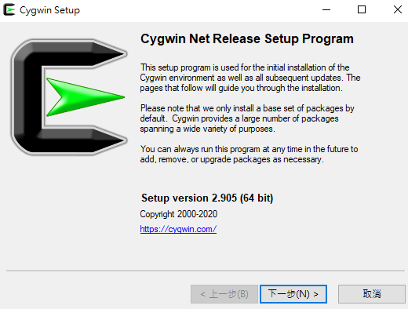
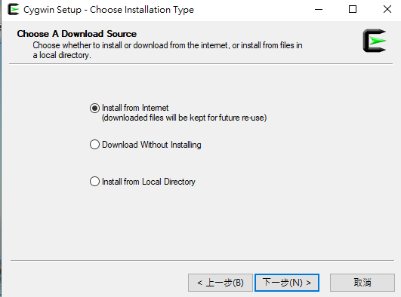
Cygwin64 installation

Slide 9
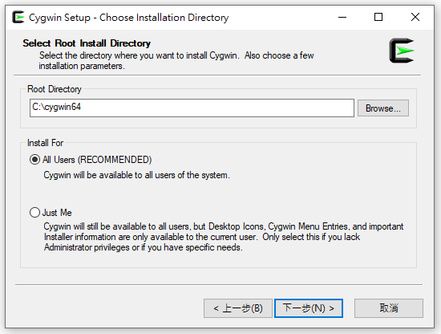
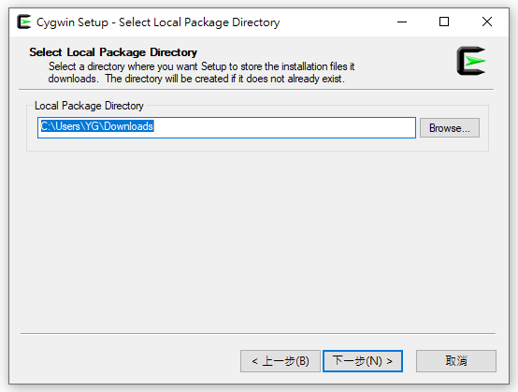
Cygwin64 installation

Slide 10
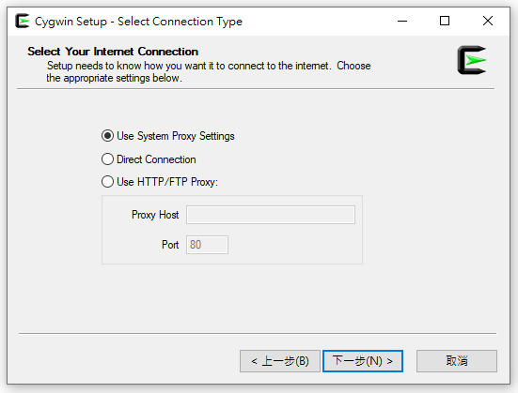
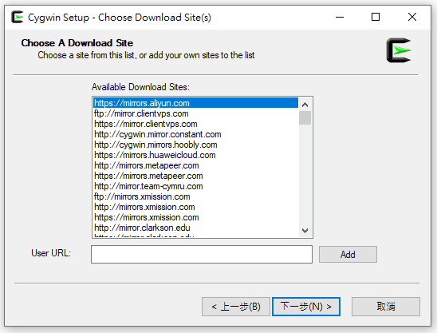
Cygwin64 installation

Slide 11
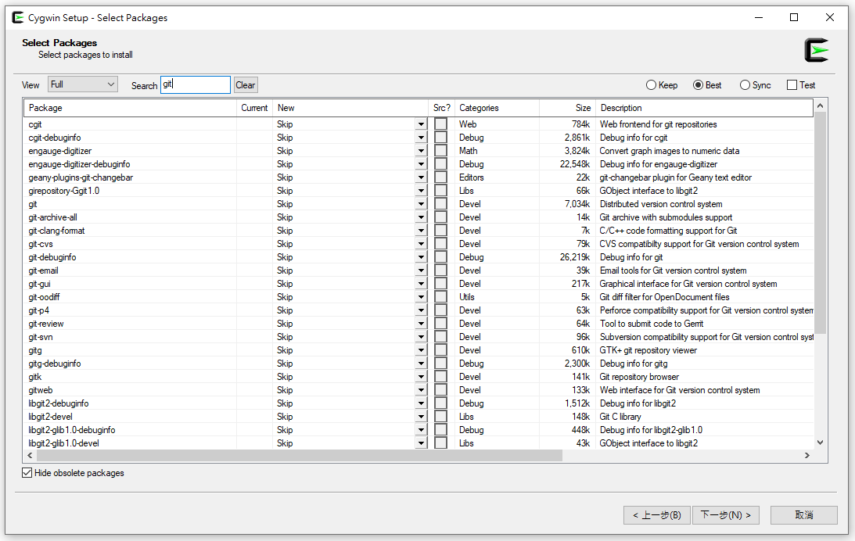
Cygwin64 installation
Search: git , xxd, make, unzip, curl

Slide 12
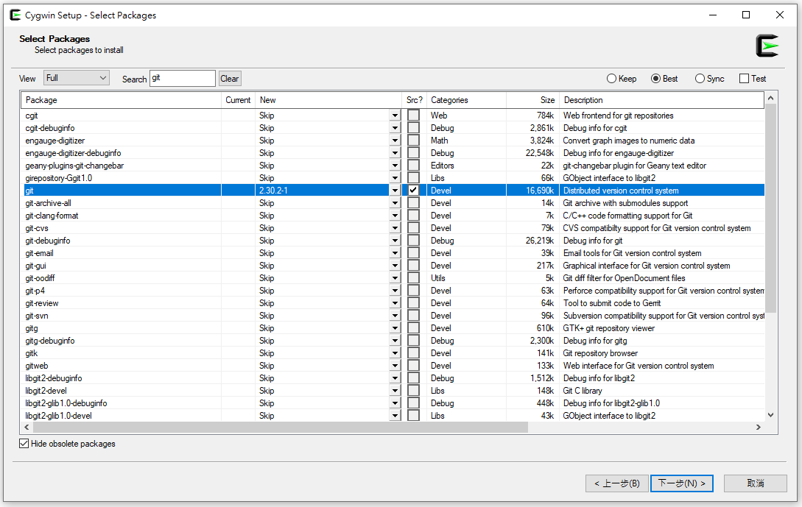

Cygwin64 installation
1. 按 選擇最新版本
2. 打勾
3. 請重複以上步驟在Search的欄位依序搜尋: git, xxd, make, unzip, curl 且選擇版本&打勾
4. 上述完成後再按

Slide 13
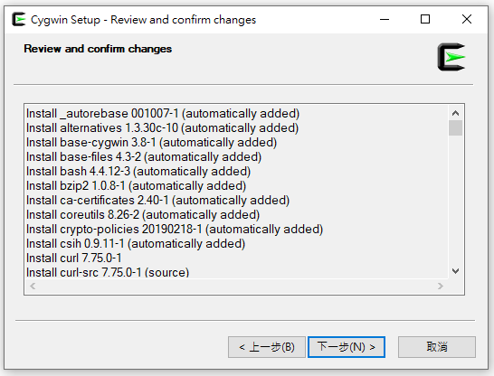
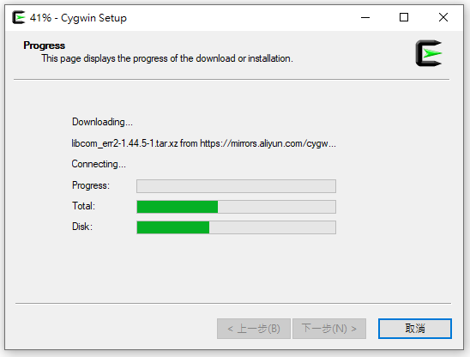
Cygwin64 installation

Slide 14
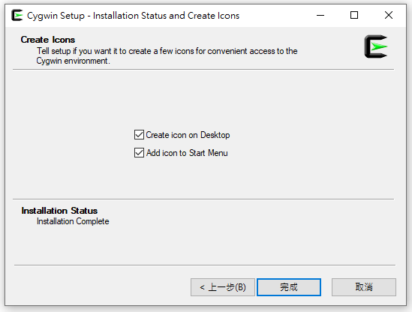
Cygwin64 installation

Slide 15
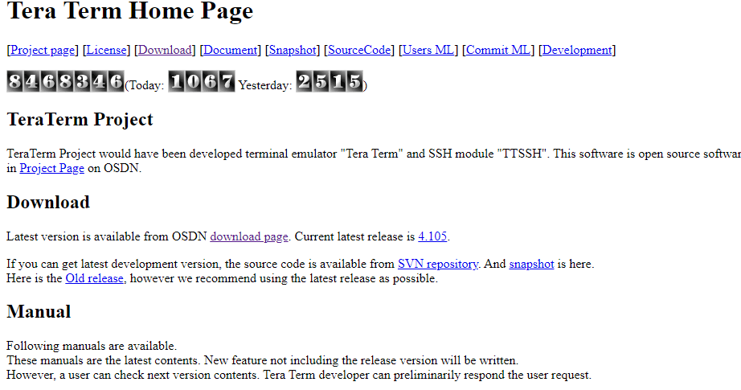
Teraterm Installation
Go to https://ttssh2.osdn.jp/index.html.en

Slide 16
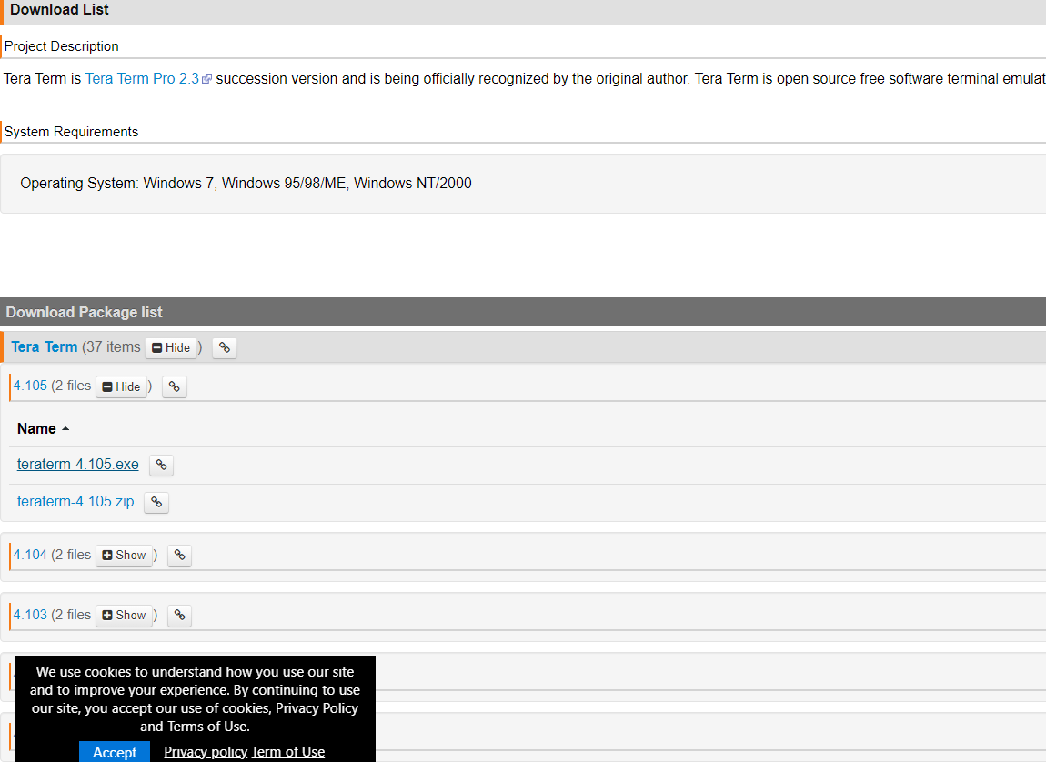
Teraterm Installation
Download teraterm-4 .105.exe

Slide 17
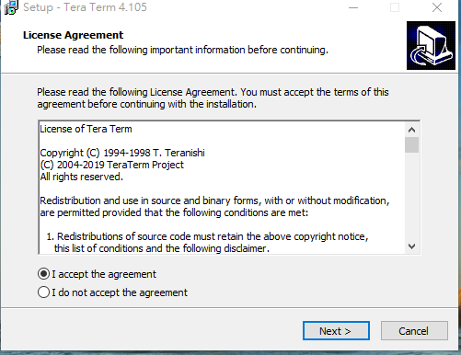
Teraterm Installation
Accept the agreement after reading it and select next

Slide 18
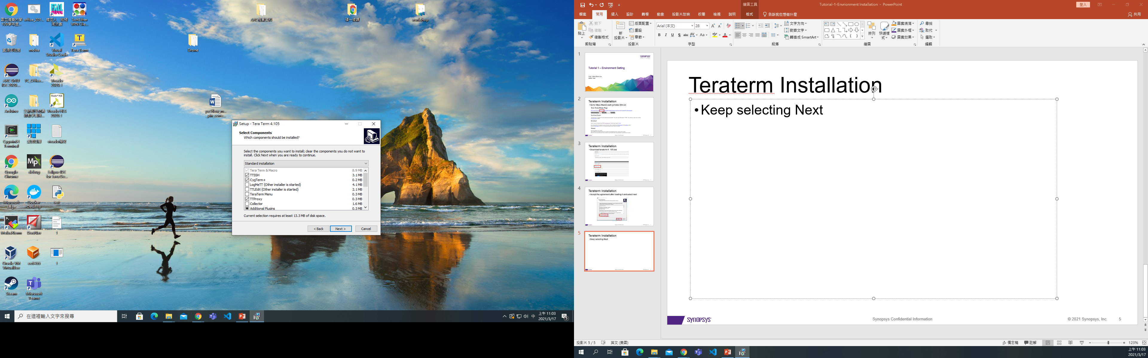
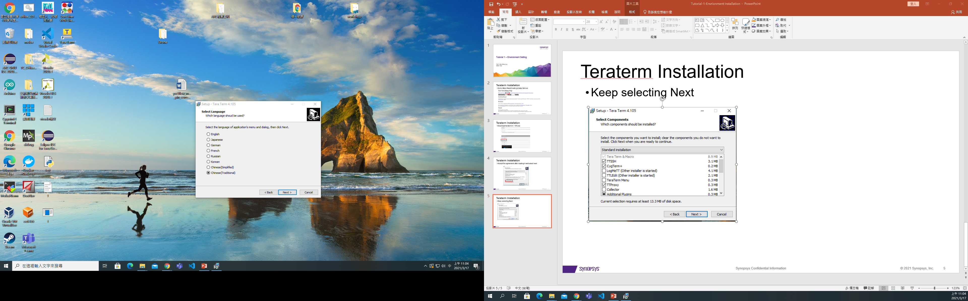
Teraterm Installation
Keep selecting Next
English or Chinese(Traditional) is recommended in this workshop

Slide 19
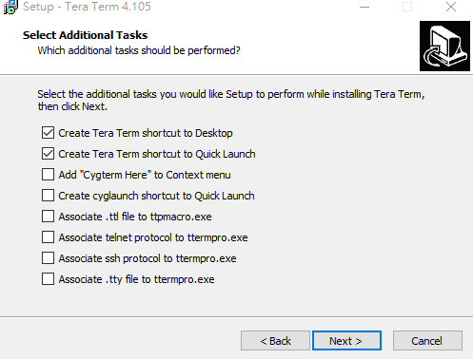
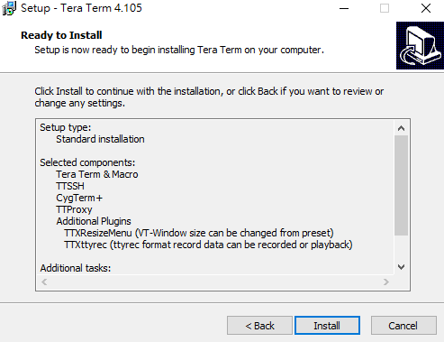
Teraterm Installation
Keep selecting Next and install

Slide 20
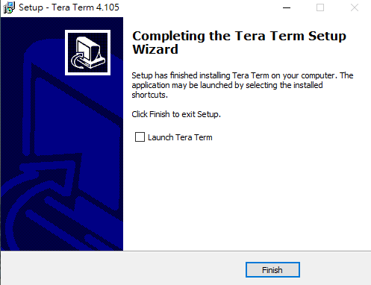
Teraterm Installation
Done

Slide 21
Install ARC GNU ToolChain

Slide 22
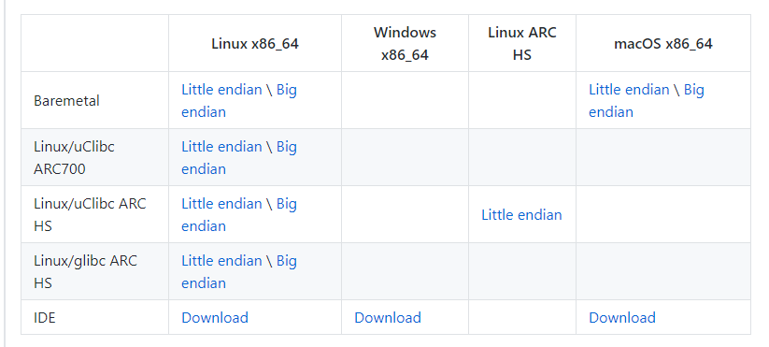
Installation of ARC GNU ToolChain
Step 1 – Go to the download page : https://github.com/foss-for-synopsys-dwc-arc-processors/toolchain/releases/

Slide 23
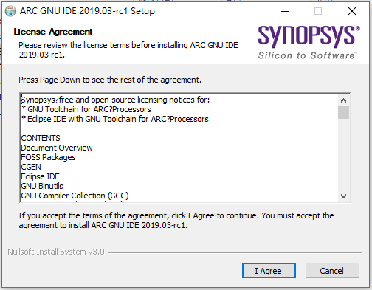
Installation of ARC GNU ToolChain
Step 2 – Double click the installation file and press I Agree

Slide 24
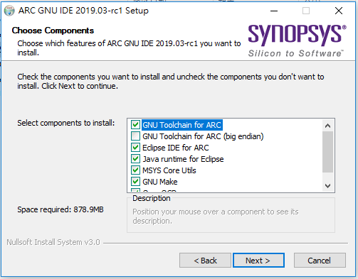
Installation of ARC GNU ToolChain
Step 3 – Press Next

Slide 25
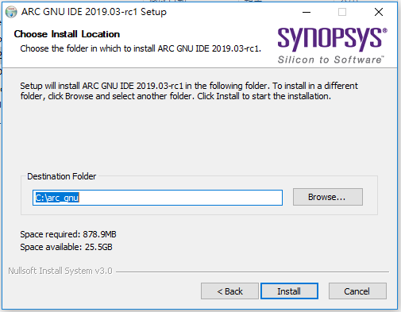
Installation of ARC GNU ToolChain
Step 4 – Press Install

Slide 26
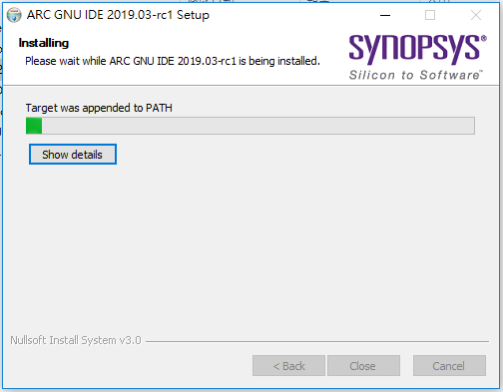
Installation of ARC GNU ToolChain
Step 5 – Start to install…

Slide 27
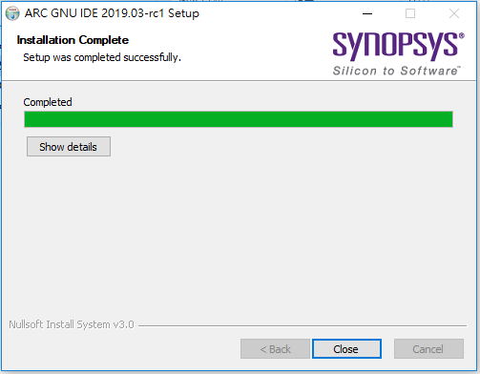
Installation of ARC GNU ToolChain
Step 6 – Press close and complete the installation

Slide 28
Install VScode

Slide 29
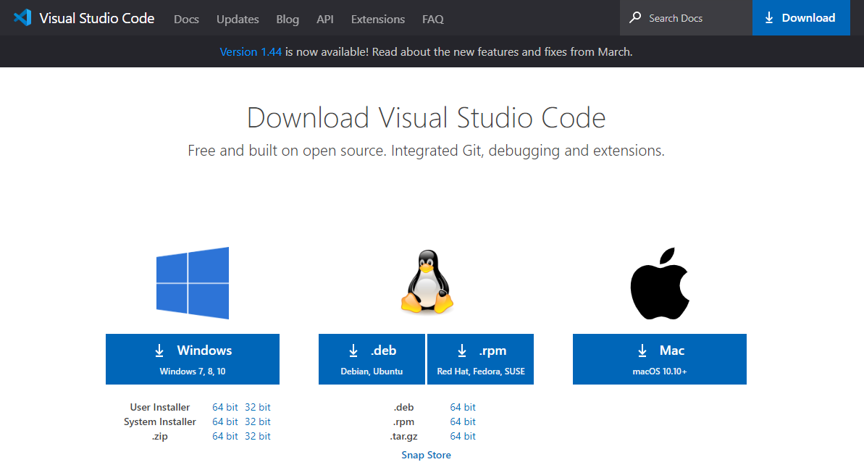
Installation of VScode
Step 1 – Go to download page of VScode : https://code.visualstudio.com/download and press download

Slide 30
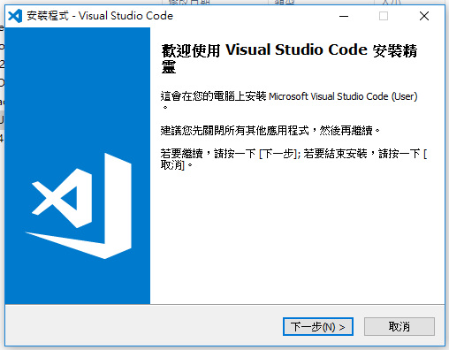
Installation of VScode
Step 2 – Double click the installation file and press next

Slide 31
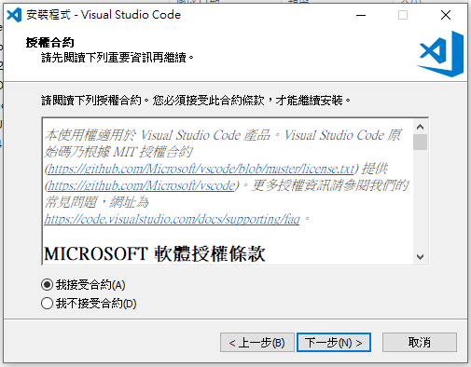
Installation of VScode
Step 2 – Accept the contract and press next

Slide 32
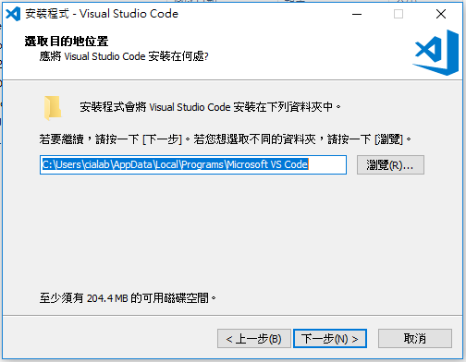
Installation of VScode
Step 3 – Press next

Slide 33
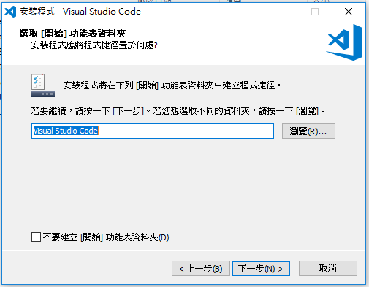
Installation of VScode
Step 4 – Press next

Slide 34
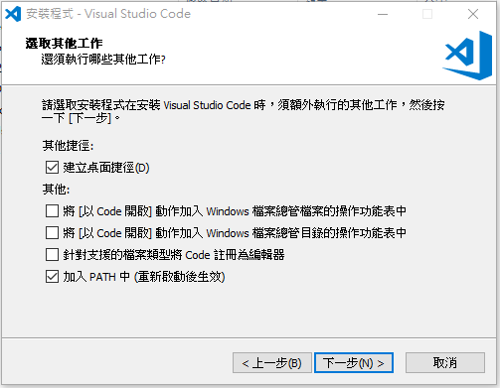
Installation of VScode
Step 5 – Press next

Slide 35
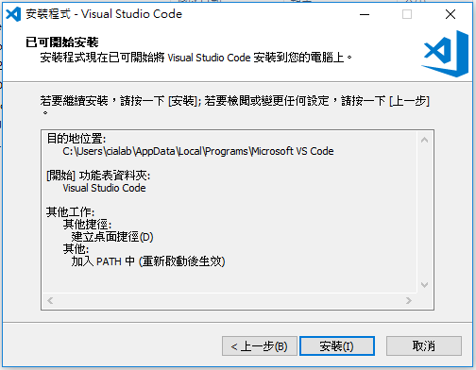
Installation of VScode
Step 6 – Press install

Slide 36
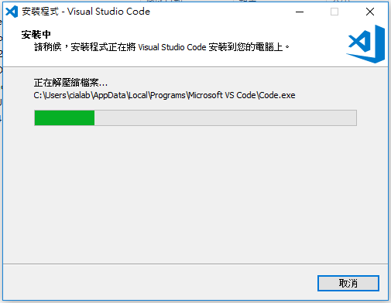
Installation of VScode
Step 7 – Start to install…

Slide 37

Installation of VScode
Step 8 – Press finish

Slide 38
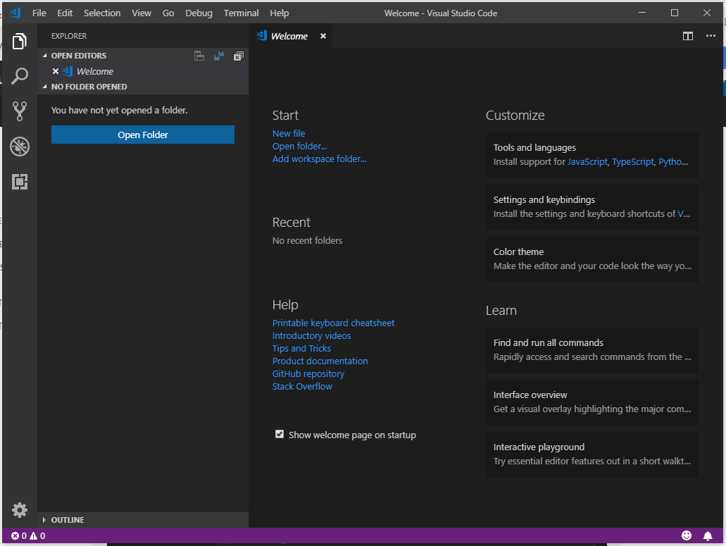
Installation of VScode
Step 9 – Try to open the VScode

Slide 39
Install Git

Slide 40
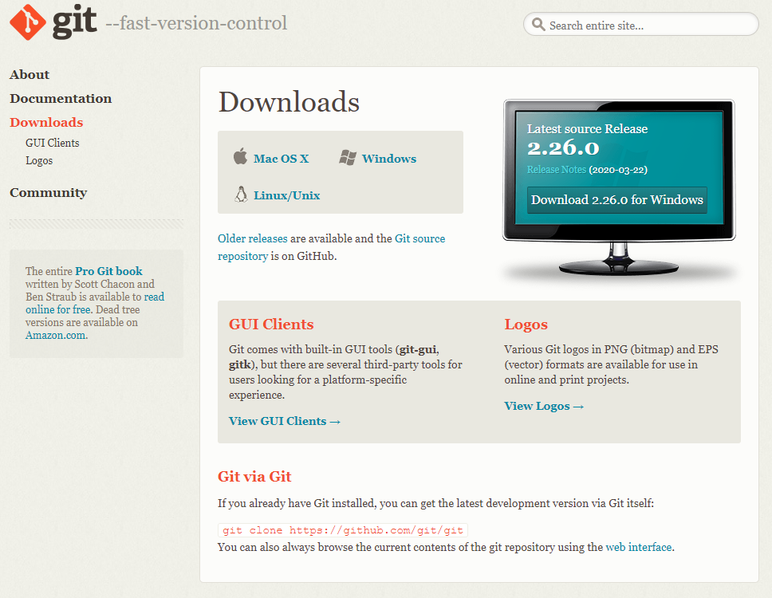
Installation of Git
Step 1 – Go to the download page : https://git-scm.com/downloads

Slide 41
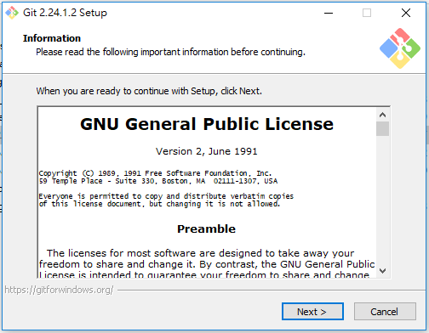
Installation of Git
Step 2 – Double click the installation file and press Next

Slide 42
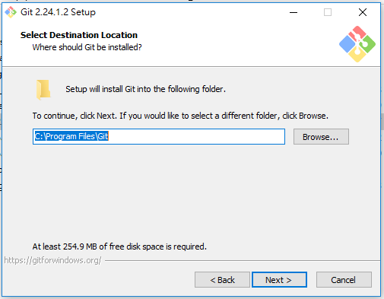
Installation of Git
Step 3 –Press Next

Slide 43
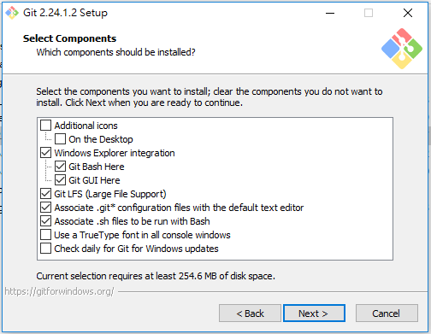
Installation of Git
Step 4 –Press Next

Slide 44
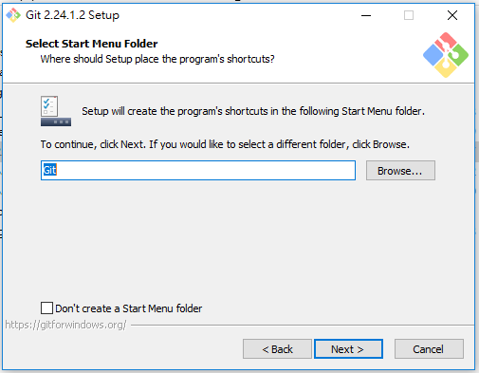
Installation of Git
Step 5 –Press Next

Slide 45
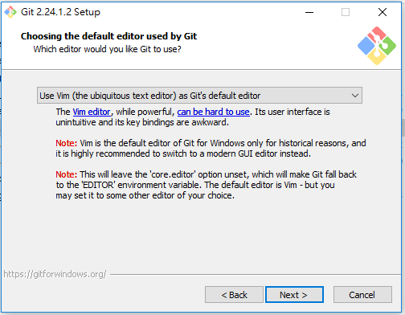
Installation of Git
Step 6 –Press Next

Slide 46

Installation of Git
Step 7 –Press Next

Slide 47

Installation of Git
Step 8 –Press Next

Slide 48

Installation of Git
Step 9 –Press Next

Slide 49

Installation of Git
Step 10 –Press Next

Slide 50

Installation of Git
Step 11 –Press Next

Slide 51

Installation of Git
Step 12 –Press Install

Slide 52

Installation of Git
Step 13 – Start to install…

Slide 53

Installation of Git
Step 14 – Press Finish and complete the installation

